Slide 1
Visualizing Sorting Algorithms
By: problem sorters
Members
Amaan khan ct-25077
Ammar hussain ct-25080
Ali ahmed ct-25096

Slide 2
What is Sorting?
Sorting means arranging numbers in order.
Example:
Unsorted: 3, 1, 4, 2
Sorted: 1, 2, 3, 4
Sorting helps organize data and search faster.
Binary search requires sorting.

Slide 3
Types of sorting algorithm
In this presentation we are going to talk about three type of sorting algorithms.
Bubble Sort
Insertion Sort
Merge Sort

Slide 4
Objective
Understand how Bubble Sort works
Learn to compare and swap adjacent elements
Observe how sorting progresses step-by-step
Understand its performance limitations

Slide 5
Bubble sort
In this algorithm, two consecutive elements are checked repeatedly and are swapped if they fulfill the condition.
After one complete iteration in the array, if the sorting is done in ascending order, the largest element gets “bubbled” to the end of the array.

Slide 6
How Bubble Sort Works
Compare each pair of adjacent elements
Swap them if they are in the wrong order
Repeat this process until the list is sorted
Each full pass moves the next largest value to the end.

Slide 7
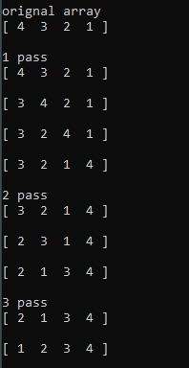
Visual Example

Slide 8
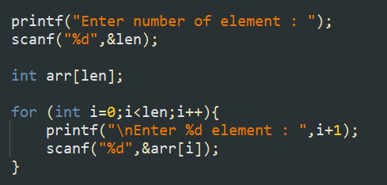
Code Overview
Input array size and elements
Choose ascending or descending order

Slide 9
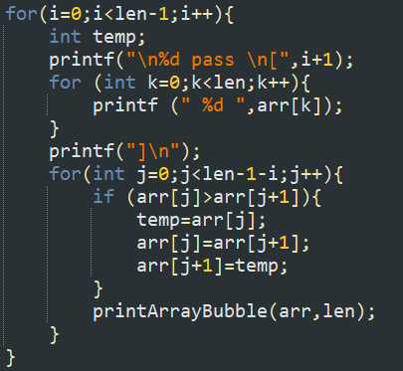


Code Overview
Loop through array comparing and swapping
Display array after each round

Slide 10
Time & Space Complexity
Best Case: O(n)
Average Case: O(n²)
Worst Case: O(n²)
Space Complexity: O(1) — sorts in place, no extra memory used

Slide 11
Use Case
Works well for small or nearly sorted lists
Great for teaching sorting basics
Replaced by faster algorithms in real applications (Merge Sort, Quick Sort)

Slide 12
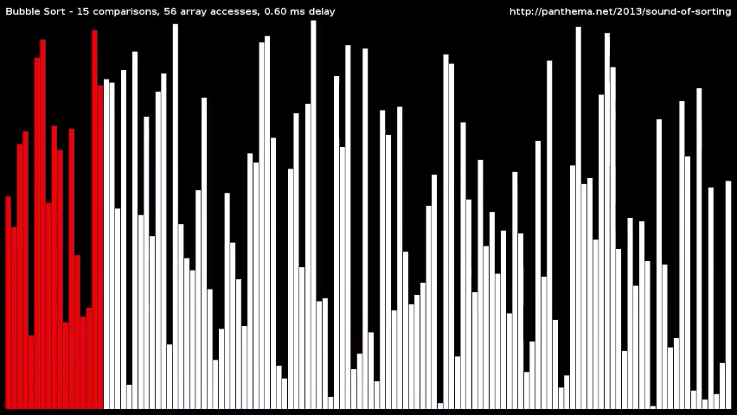
Bubble Sort

Slide 13
Conclusion
Bubble Sort is easy to understand and implement.
It helps beginners visualize how sorting happens step-by-step.
Though inefficient for large datasets, it builds a foundation for learning advanced sorting techniques.

Slide 14
Insertion sort
In this algorithm we start from the left most element of the array and consider it sorted.
Then we start comparing it with its neighboring elements, and if it is bigger, it is then swapped with that element.

Slide 15
Objective
Understand how Insertion Sort works.
Learn to compare and insert elements step-by-step.
Observe sorting progress visually.
Understand performance characteristics.

Slide 16
How Insertion Sort Works
Start with the second element assuming that the first element is sorted.
Compares the current element with each element in the sorted portion from right to left.
Shifts any larger elements to the right to make space.
Insert the current element in the correct position.
Repeat for all elements until the whole list is sorted.

Slide 17
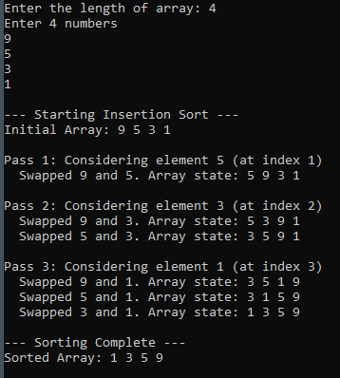
Visual Example

Slide 18
Code overview
Declare array and variables
Input array size and elements
Loop starting from the second element
Compare and shift larger elements
Insert current element in position
Repeat until sorted

Slide 19
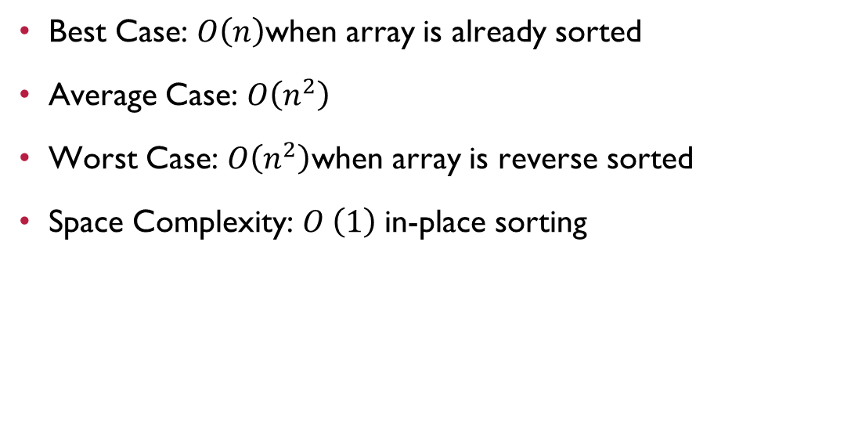
Time & space complexity
Best Case: $O\left(n\right)$when array is already sorted
Average Case: $O\left(n^{2}\right)$
Worst Case: $O\left(n^{2}\right)$when array is reverse sorted
Space Complexity: $O \left(1\right)$in-place sorting

Slide 20
Conclusion
Insertion Sort is intuitive and easy to implement.
It helps understand sorting fundamentals and is efficient for small or nearly sorted data. Better algorithms exist for large or random data.

Slide 21
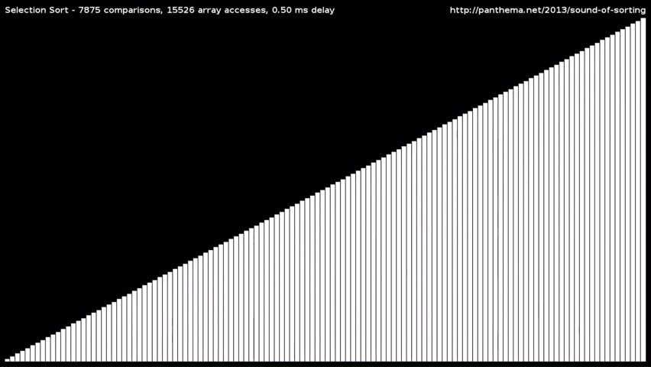
Insertion Sort

Slide 22
Merge Sort
In this algorithm, we use the “Divide and Conquer” technique.
It is done in the following manner:
Split the array into smaller sub-arrays
Keep splitting until each sub-array has one number
Merge the sub-arrays back in order

Slide 23
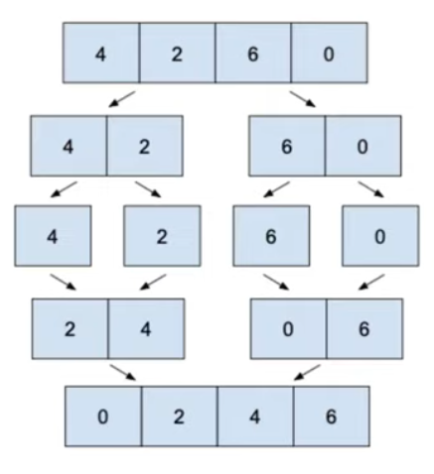
VISUAL EXAMPLE

Slide 24
recursion
An important concept that merge sort uses is recursion.
Recursion happens when a function calls itself.
This works a bit like while loop.
Firstly we have to check if a condition is true or not, only then the function could call itself.
This is known as the General Case-when the function keeps running.
When the condition becomes false, the function stops calling itself, also known as reaching the Base Case.

Slide 25
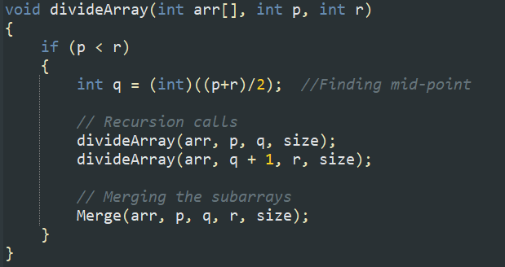
How We Split the arrays
We take the middle number to divide the array.
Example: [3,1,4,2]
Middle = 2
Left: [3,1]
Right: [4,2]
Repeat until sub-array has 1 element.

Slide 26
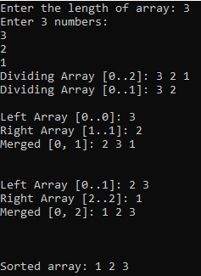
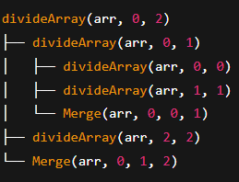
Imagining Recursion as a tree
Suppose if we have an array of 3 elements with values [3,2,1].
Then it would look something like this

Slide 27
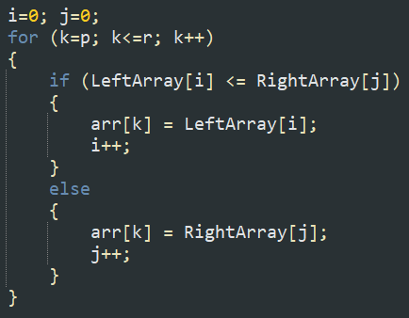
How We Merge
Combine two small sorted lists into a bigger sorted list.
Example:
[3] + [1] → [1,3]
[4] + [2] → [2,4]
[1,3] + [2,4] → [1,2,3,4]

Slide 28
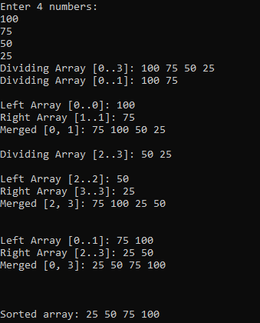
Output Example

Slide 29
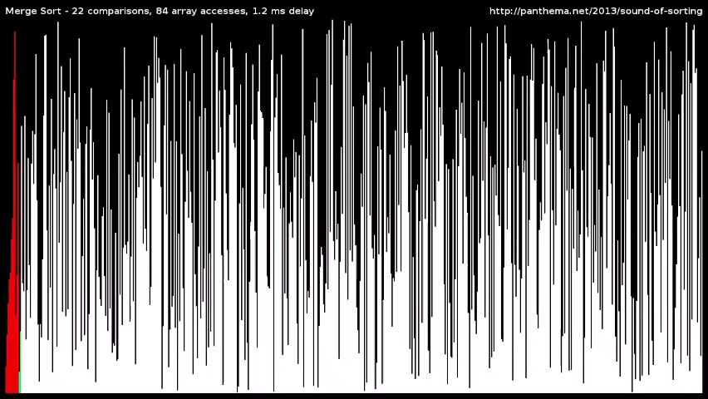
Visualization of Merge Sort

Slide 30
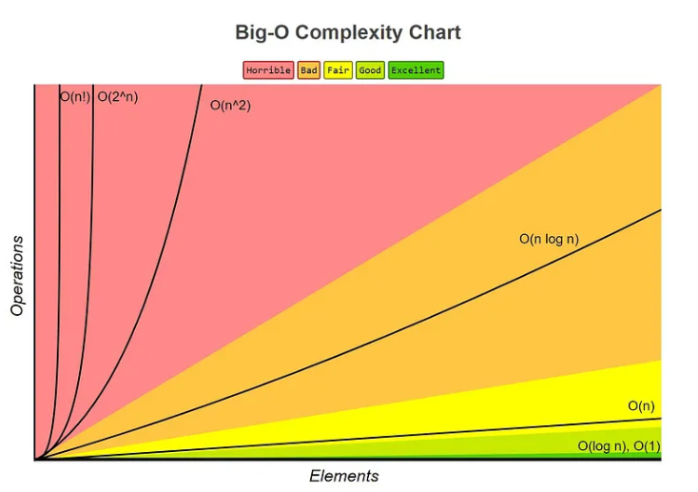
Efficiency graph of big(o)

Slide 31
Why Merge Sort is Efficient
Each step splits the list in half → log(n) splits
Each merge touches all numbers → n comparisons
Total steps = n * log(n)
Faster than simple sorts for big arrays

Slide 32
Key Takeaways
Merge Sort splits first, merges later.
Efficient for large lists.
Visualization helps beginners.

Slide 33
Thank you
Check out our GitHub repository

